Slide 1

WEBSITE QUẢN LÝ CHI TIÊU
Giảng viên: THS.Nguyễn Mạnh Tuấn

Slide 2
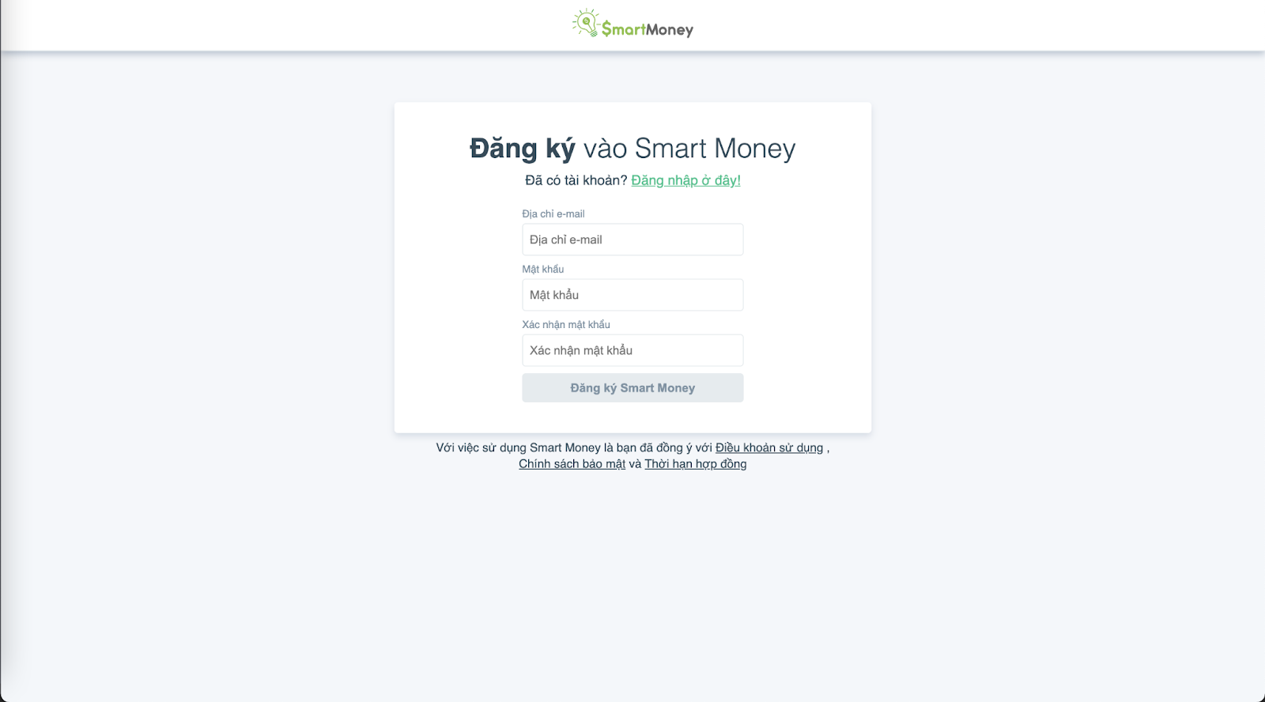
SIGIN UP

Slide 3
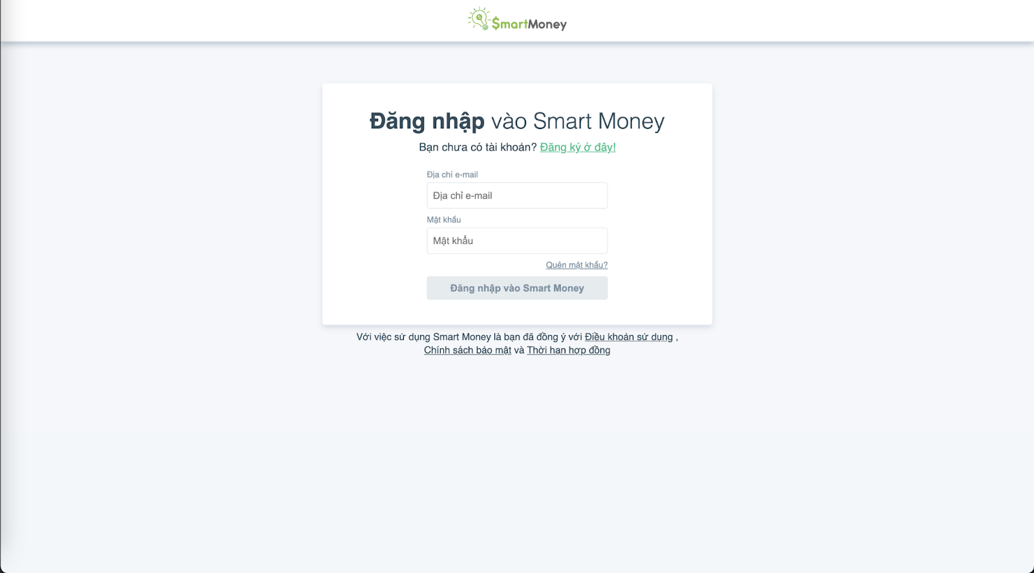
2. LOGIN

Slide 4
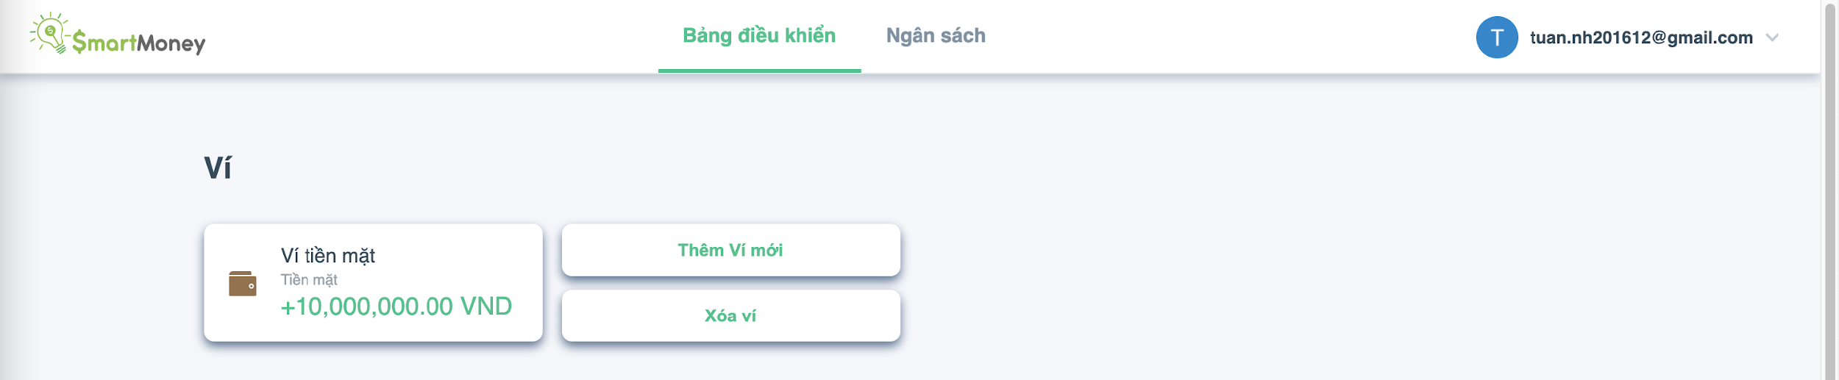
3. DASHBORAD

Slide 5
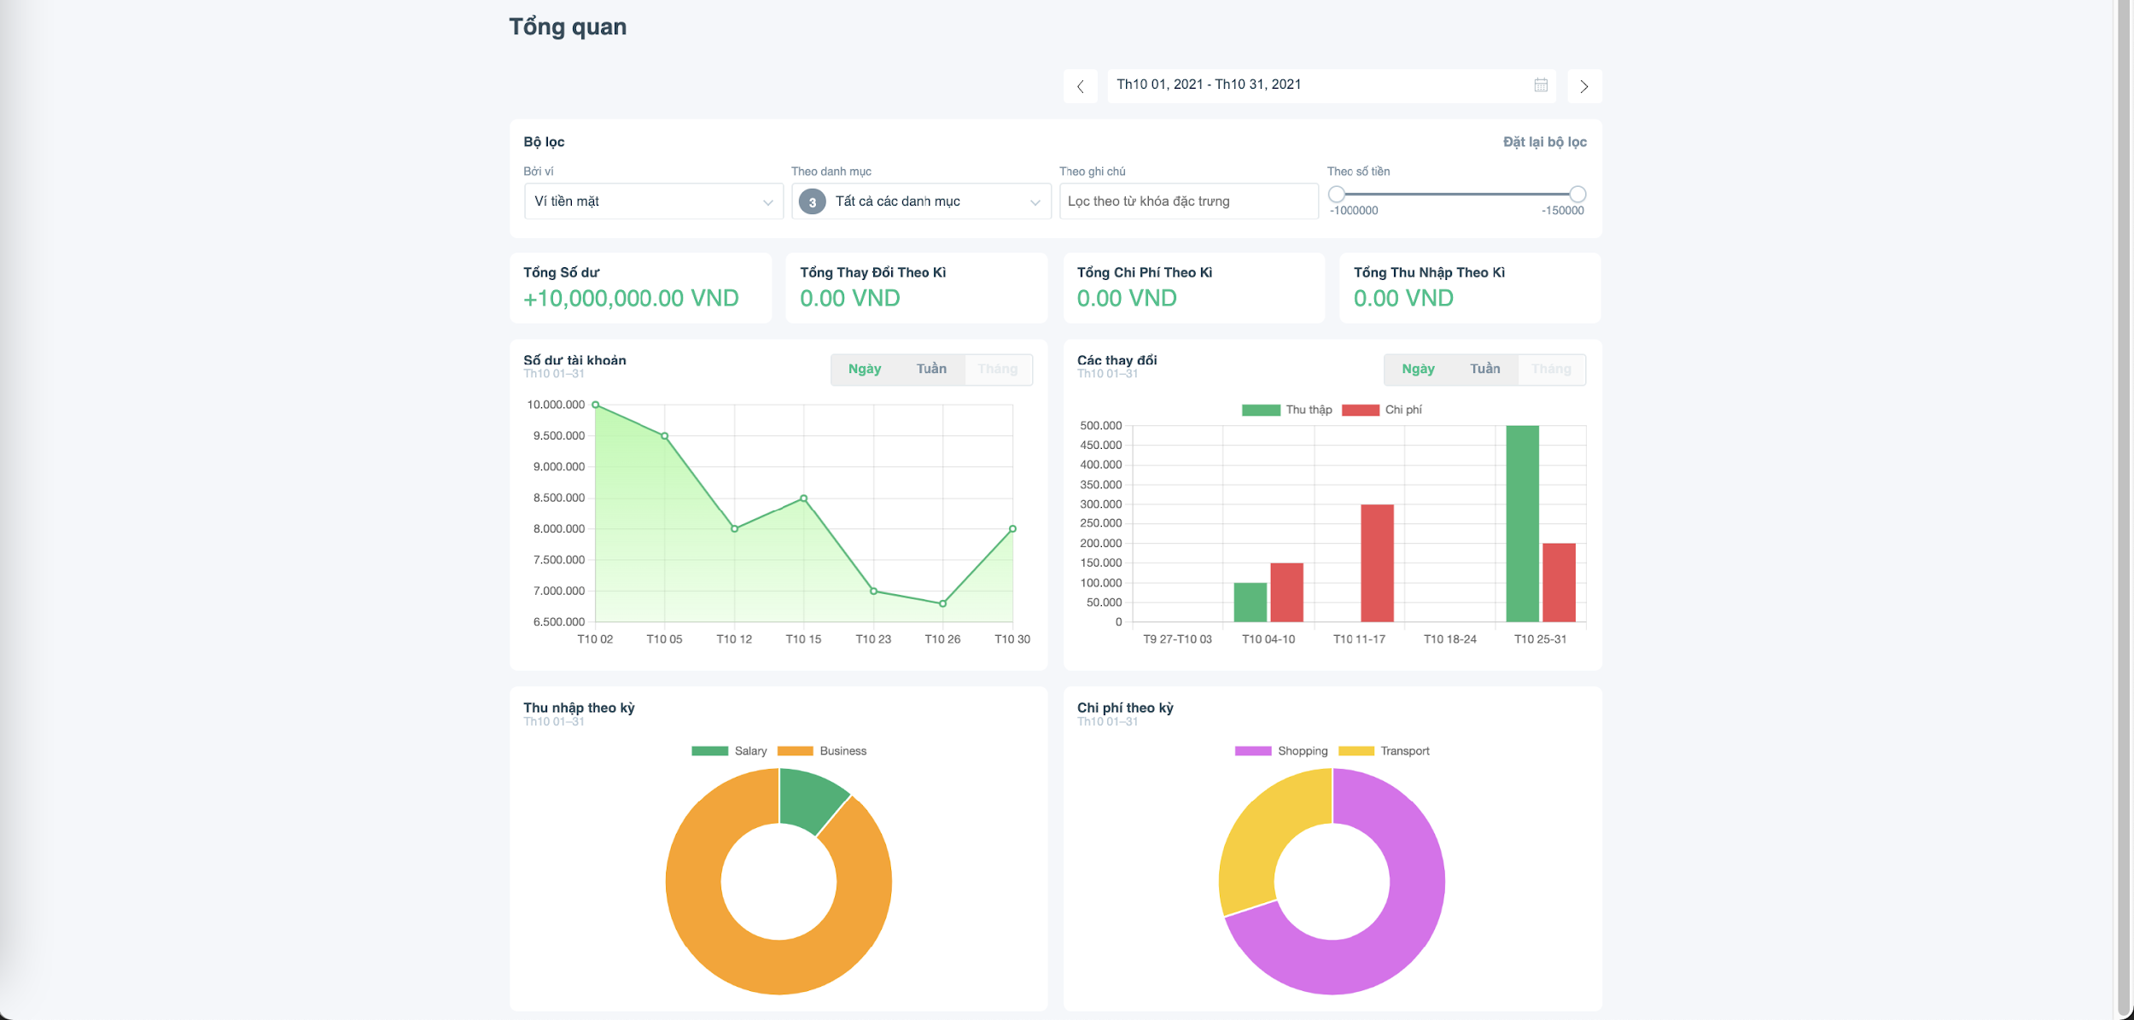
4. DASHBORAD

Slide 6
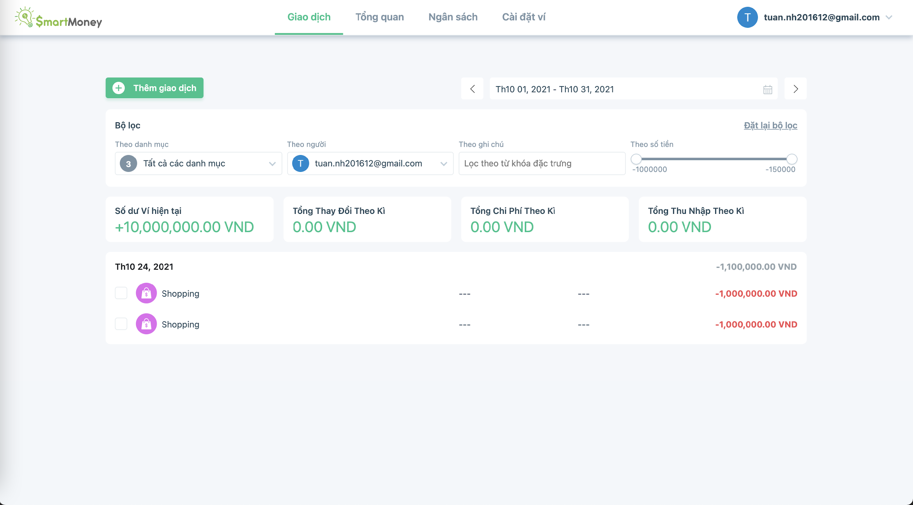
5. WALLET transactions

Slide 7
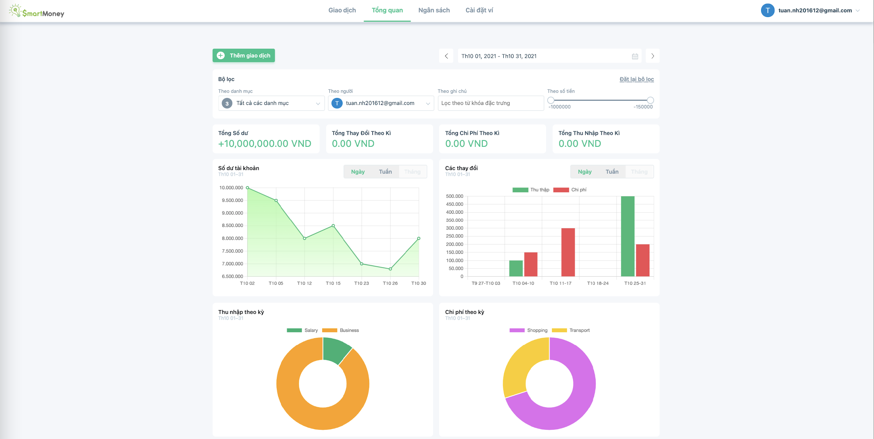
6. WALLET - overview

Slide 8
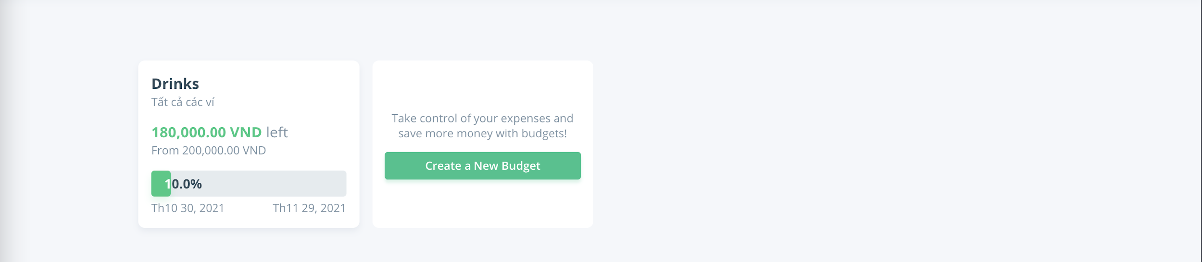
7. WALLET - budgets

Slide 9
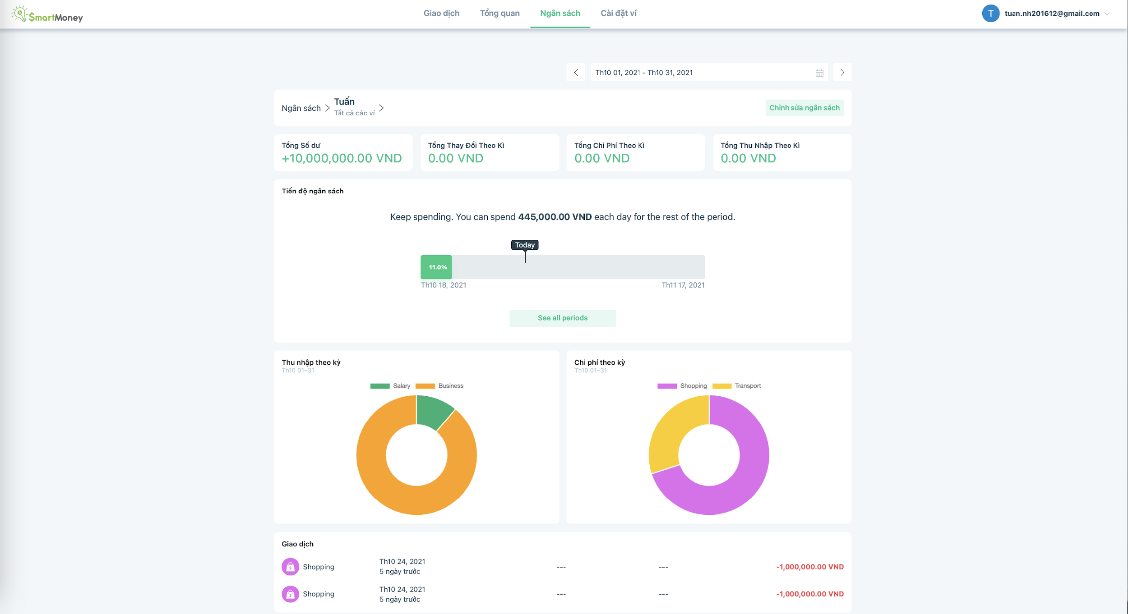
8. WALLET - budgets

Slide 10
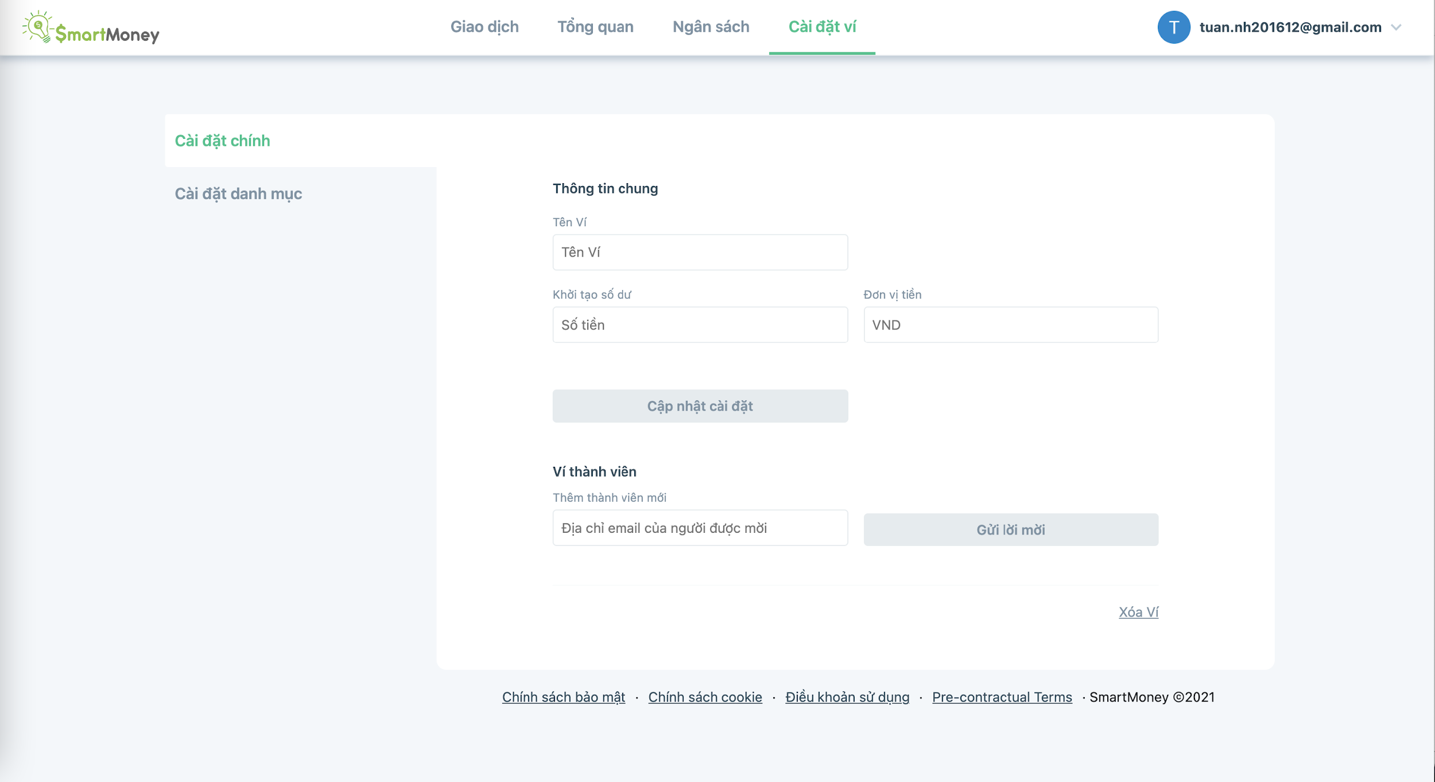
9. WALLET - settings

Slide 11
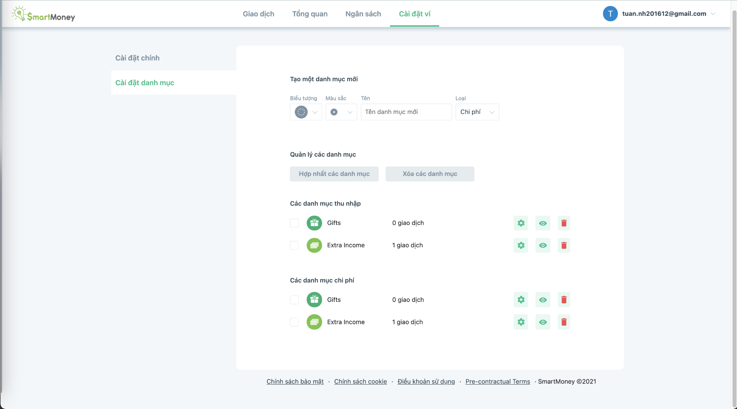
10. WALLET - settings

Slide 12
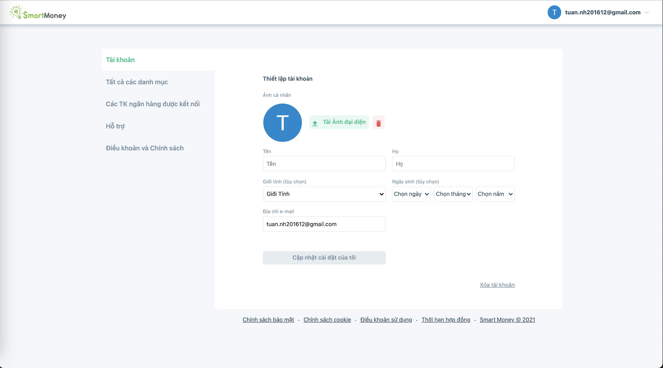
11. Account - settings

Slide 13
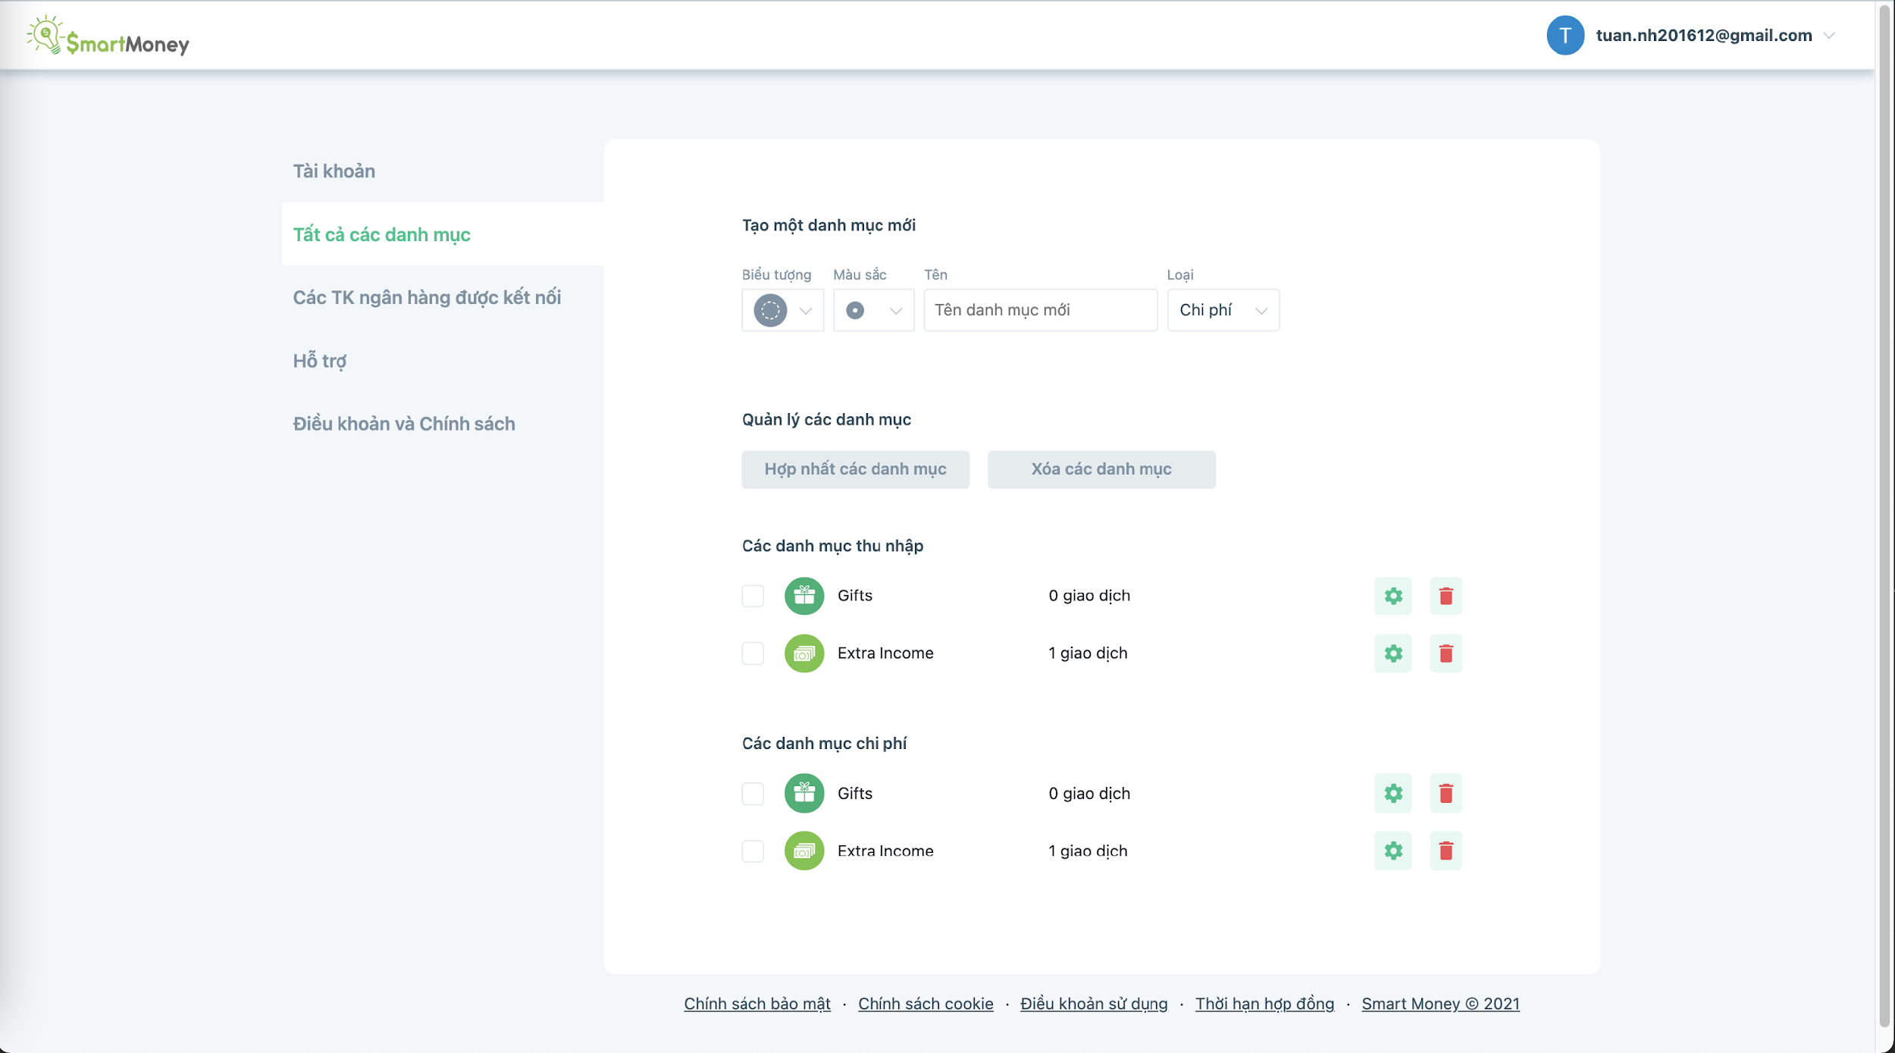
12. Account - settings

